Slide 1


Predicting Oscar Nominees: A Multiclass Classification Approach Using Machine Learning
Hui, Macarious
Wu, Victor
Zhang, Tianyi

Slide 2

Motivation
Oscar Significance & Complexity:
The Oscars not only celebrate cinematic achievements but also influence careers and revenues. However, the nomination process is complex, influenced by cultural, economic, and political factors.
Machine Learning for Prediction & Transparency:
We utilize machine learning to predict Oscar nominations, aiming to unravel the complexities and bring transparency to the nomination process in various categories.

Slide 3

Datasets
Oscar nominations (Kaggle)
Golden Globe nominations (Kaggle)
SAG Award nominations (Kaggle)
The Movies Dataset
IMDb Datasets

Slide 4
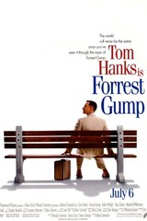
Features
Release year, release month
Language
Genre
Budget, revenue
Runtime
Production Companies
Age of actors / actresses / directors / writers
Ratings, and number of votes on IMDb
Golden Globe nominations
SAG nominations

Slide 5

Class Labels – Oscar Nominations
Best Picture
Actor in a Leading Role
Actress in a Leading Role
Cinematography
Directing
Film Editing
Actor in a Support Role
Actress in a Supporting Role
Costume Design
Sound
Visual Effects
Animated Feature Film
Production Design
Big 3
Notes:
Oscars dataset, Golden Globe dataset, SAG dataset
Merge categories and remove.combine outdated or renamed categories (Best New Star, etc.)
Turn into features/labels (nominations and wins per category
IMDb API to convert film titles from to imdb_id
IMDb dataset, tmdb dataset
production company
budget/revenue
rating
actor/actress ages
country, etc.
dataset combined on imdb_id

Slide 6
Logistic Regression
Victor

Slide 7

Method 1: Logistic Regression
MultiOutputClassification
Logistic Regression Estimator - Label #1
Logistic Regression Estimator - Label #2
Logistic Regression Estimator - Label #3
Logistic Regression Estimator - Label #13
…
Output - 2013
Output - 2014
Output - 2015
Output - 2016
Output - 2017

Slide 8

Logistic Regression: Training
test/train
training data - movies from 1927 to 2012, inclusive.
test data - movies from 2013 to 2017, inclusive
parameter optimization
solver - [liblinear]
regularization penalties - [l1, l2]
C - [0.001, 0.01, 0.1, 1, 10, 100]
cv - [5]
scoring - [f1]
optimal parameters
C = 1
penalty = l1

Slide 9
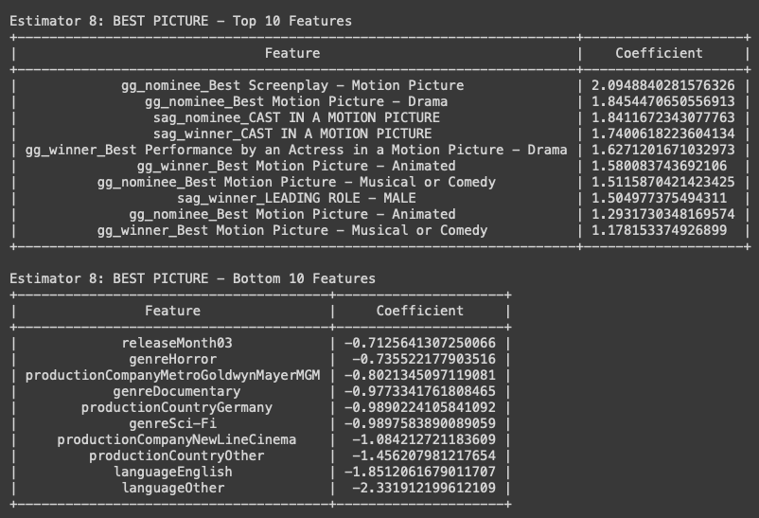

Logistic Regression: Training

Slide 10
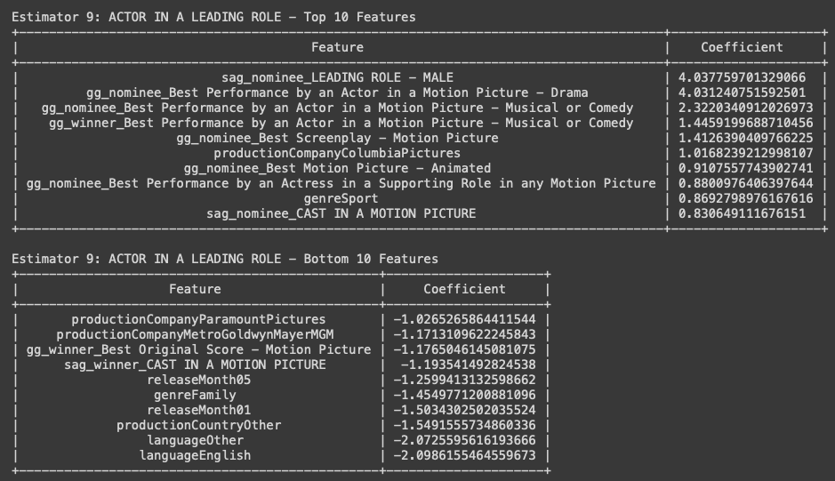

Logistic Regression: Training

Slide 11
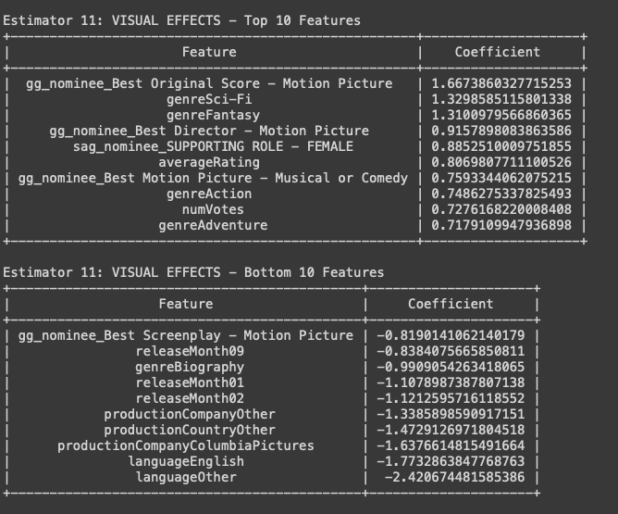

Logistic Regression: Training

Slide 12
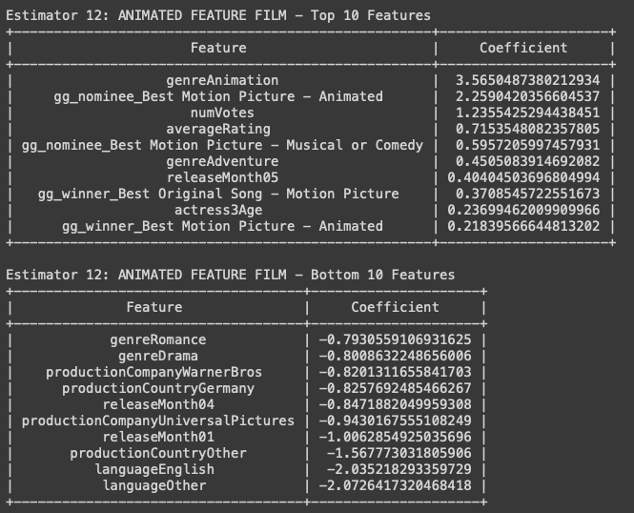

Logistic Regression: Training

Slide 13
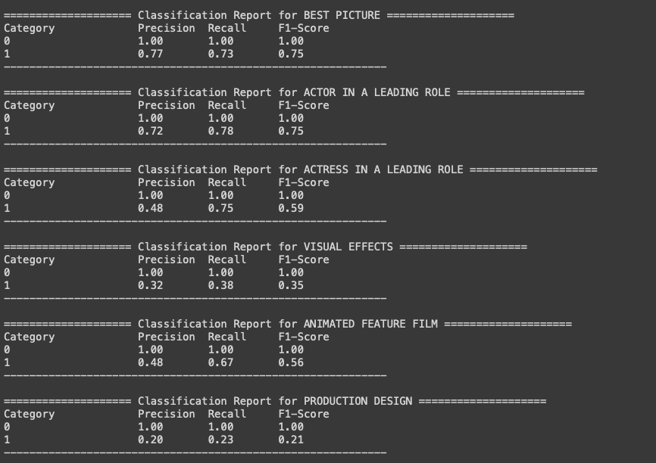

Logistic Regression: Testing

Slide 14
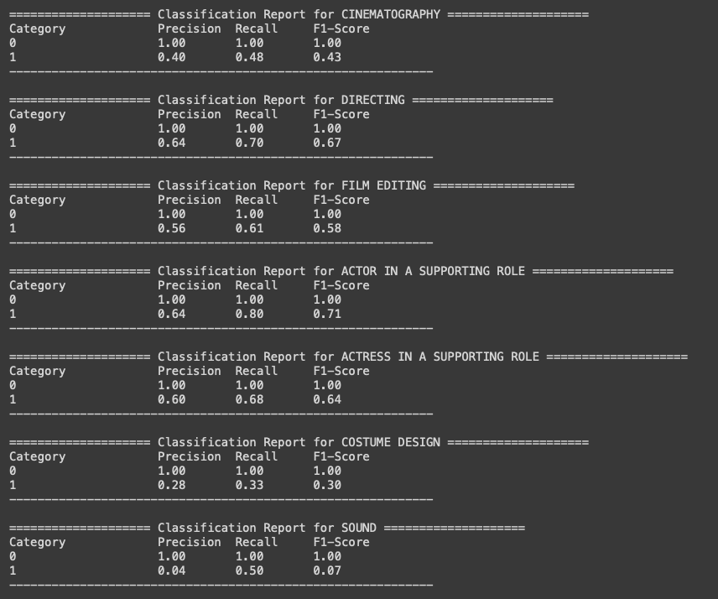

Logistic Regression: Testing

Slide 15
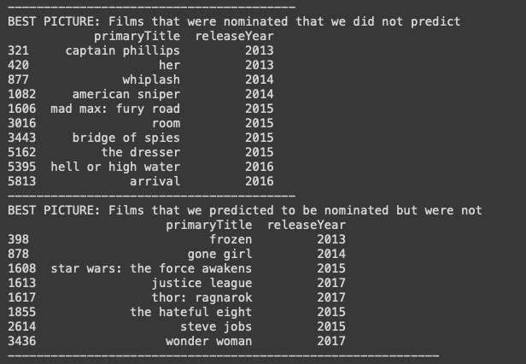

Logistic Regression: Testing

Slide 16
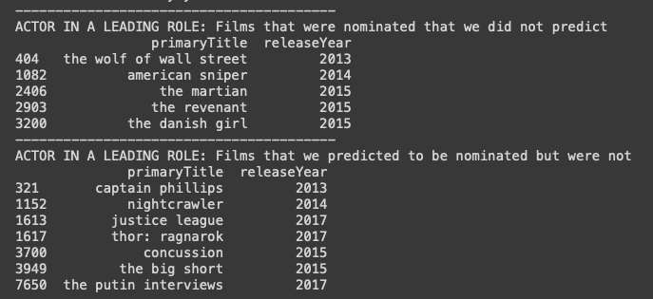

Logistic Regression: Testing

Slide 17
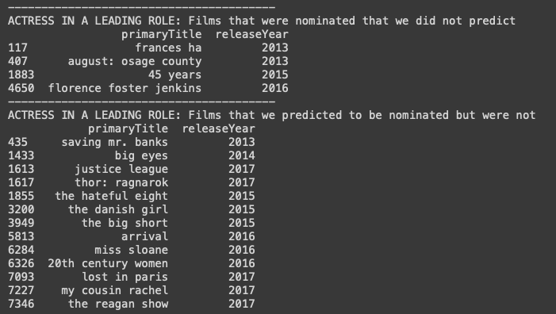

Logistic Regression: Testing

Slide 18
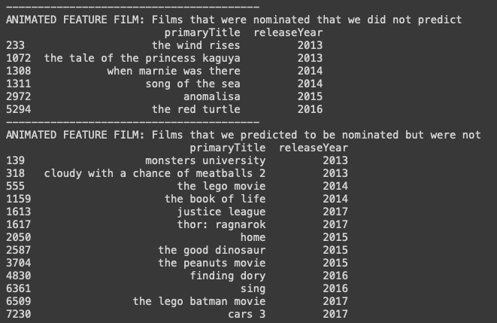

Logistic Regression: Testing

Slide 19

Logistic Regression: Conclusions
Further improvements
Decay Function
Superhero film feature
More features

Slide 20
Neural Network
Dataset Preprocessing
Extract Features / Class Labels
Split into Train / Validation / Test Sets
Feature Scaling
Model Training
Use MLPClassifier from scikit-learn
Wrap model in MultiOutputClassifier
Tune hyperparameters based on balanced accuracy on validation set
Select best model
Macarious
Model Evaluation
Predict class labels using test set
Analyze various classification metrics
Analyze feature importance

Slide 21

Neural Network: Preprocessing
Split Dataset
Dataset Preprocessing
Extract Features / Class Labels
Split into Train / Validation / Test Sets
Feature Scaling
Dataset
TRAINING
VALIDATION
TESTING
Model Training
1927 to 2010
(33514 movies)
2011 to 2012
(3395 movies)
2013 to 2017
(7912 movies)
Use MLPClassifier from scikit-learn
Wrap model in MultiOutputClassifier
Tune hyperparameters based on balanced accuracy on validation set
Select best model
Feature Scaling
Model Evaluation
Continuous Values
Remove mean and scale to unit variance
Predict class labels using test set
Analyze various classification metrics
Analyze feature importance
Binary Values
Transform (0, 1) to (-1, 1)

Slide 22
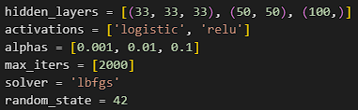

Neural Network: Model Selection
Select Model
Dataset Preprocessing
Extract Features / Class Labels
Split into Train / Validation / Test Sets
Feature Scaling
Select Parameters
Model Training
Use MLPClassifier from scikit-learn
Wrap model in MultiOutputClassifier
Tune hyperparameters based on balanced accuracy on validation set
Select best model
Model Evaluation
From Stack Overflow: The solver Limited Memory Broyden-Fletcher-Goldfarb-Shanno Algorithm (‘lbfgs’) does not use a learning rate because it is a quasi Newton method.
Predict class labels using test set
Analyze various classification metrics
Analyze feature importance

Slide 23
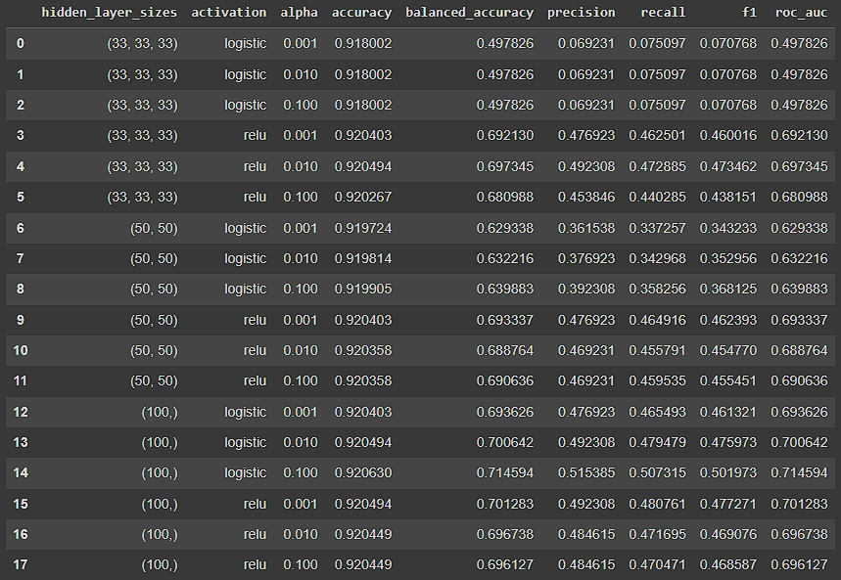

Neural Network: Parameter Tuning
Parameter Tuning Results
Dataset Preprocessing
Extract Features / Class Labels
Split into Train / Validation / Test Sets
Feature Scaling
Model Training
Use MLPClassifier from scikit-learn
Wrap model in MultiOutputClassifier
Tune hyperparameters based on balanced accuracy on validation set
Select best model
Model Evaluation
Predict class labels using test set
Analyze various classification metrics
Analyze feature importance

Slide 24
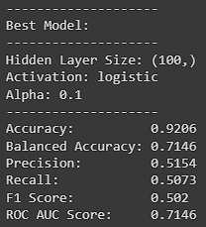

Neural Network: Select Model
Select Best Model
Dataset Preprocessing
Extract Features / Class Labels
Split into Train / Validation / Test Sets
Feature Scaling
Model Training
Use MLPClassifier from scikit-learn
Wrap model in MultiOutputClassifier
Tune hyperparameters based on balanced accuracy on validation set
Select best model
The best model is found with a balanced accuracy of 0.7146.
From scikit-learn:
“The balanced accuracy is used to deal with imbalance datasets. It is defined as the average of recall obtained on each class.”
Model Evaluation
Predict class labels using test set
Analyze various classification metrics
Analyze feature importance

Slide 25
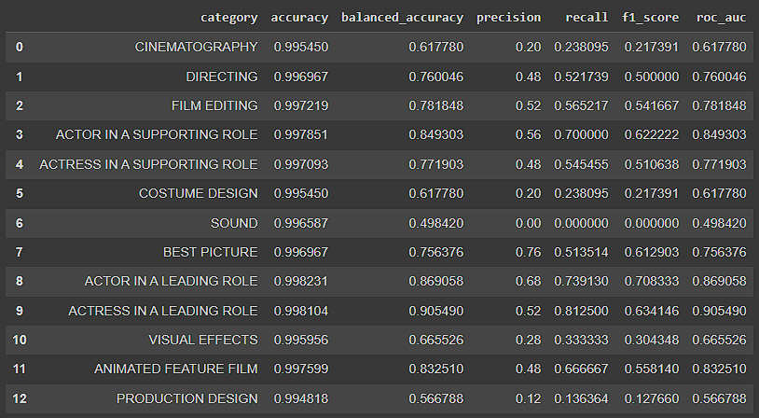

Neural Network: Evaluate Model
Evaluate the Model
Dataset Preprocessing
Extract Features / Class Labels
Split into Train / Validation / Test Sets
Feature Scaling
Model Training
Use MLPClassifier from scikit-learn
Wrap model in MultiOutputClassifier
Tune hyperparameters based on balanced accuracy on validation set
Select best model
Model Evaluation
Predict class labels using test set
Analyze various classification metrics
Analyze feature importance
In terms of balanced accuracy, ACTRESS IN A LEADING ROLE performs best, while SOUND performs worst.

Slide 26
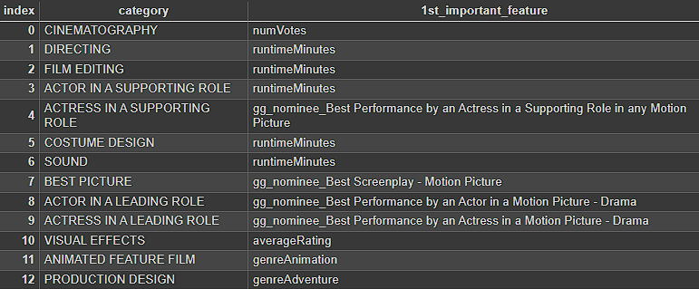

Neural Network: Feature Importance
Feature Importance
Dataset Preprocessing
Extract Features / Class Labels
Split into Train / Validation / Test Sets
Feature Scaling
Model Training
Use MLPClassifier from scikit-learn
Wrap model in MultiOutputClassifier
Tune hyperparameters based on balanced accuracy on validation set
Select best model
Model Evaluation
The sum of the absolute weights between the input and the first hidden layers are used as the feature importance.
In reality, the distribution of weights are much more complex in a neural network.
Predict class labels using test set
Analyze various classification metrics
Analyze feature importance

Slide 27

Neural Network: Conclusions
Data is very biased (very few movies are nominated)
More data can improve model performance
Want to investigate ways to capture the effect of time
Need to re-investigate feature importance as weights are complex in neural network

Slide 28
Random Forest
Tianyi

Slide 29
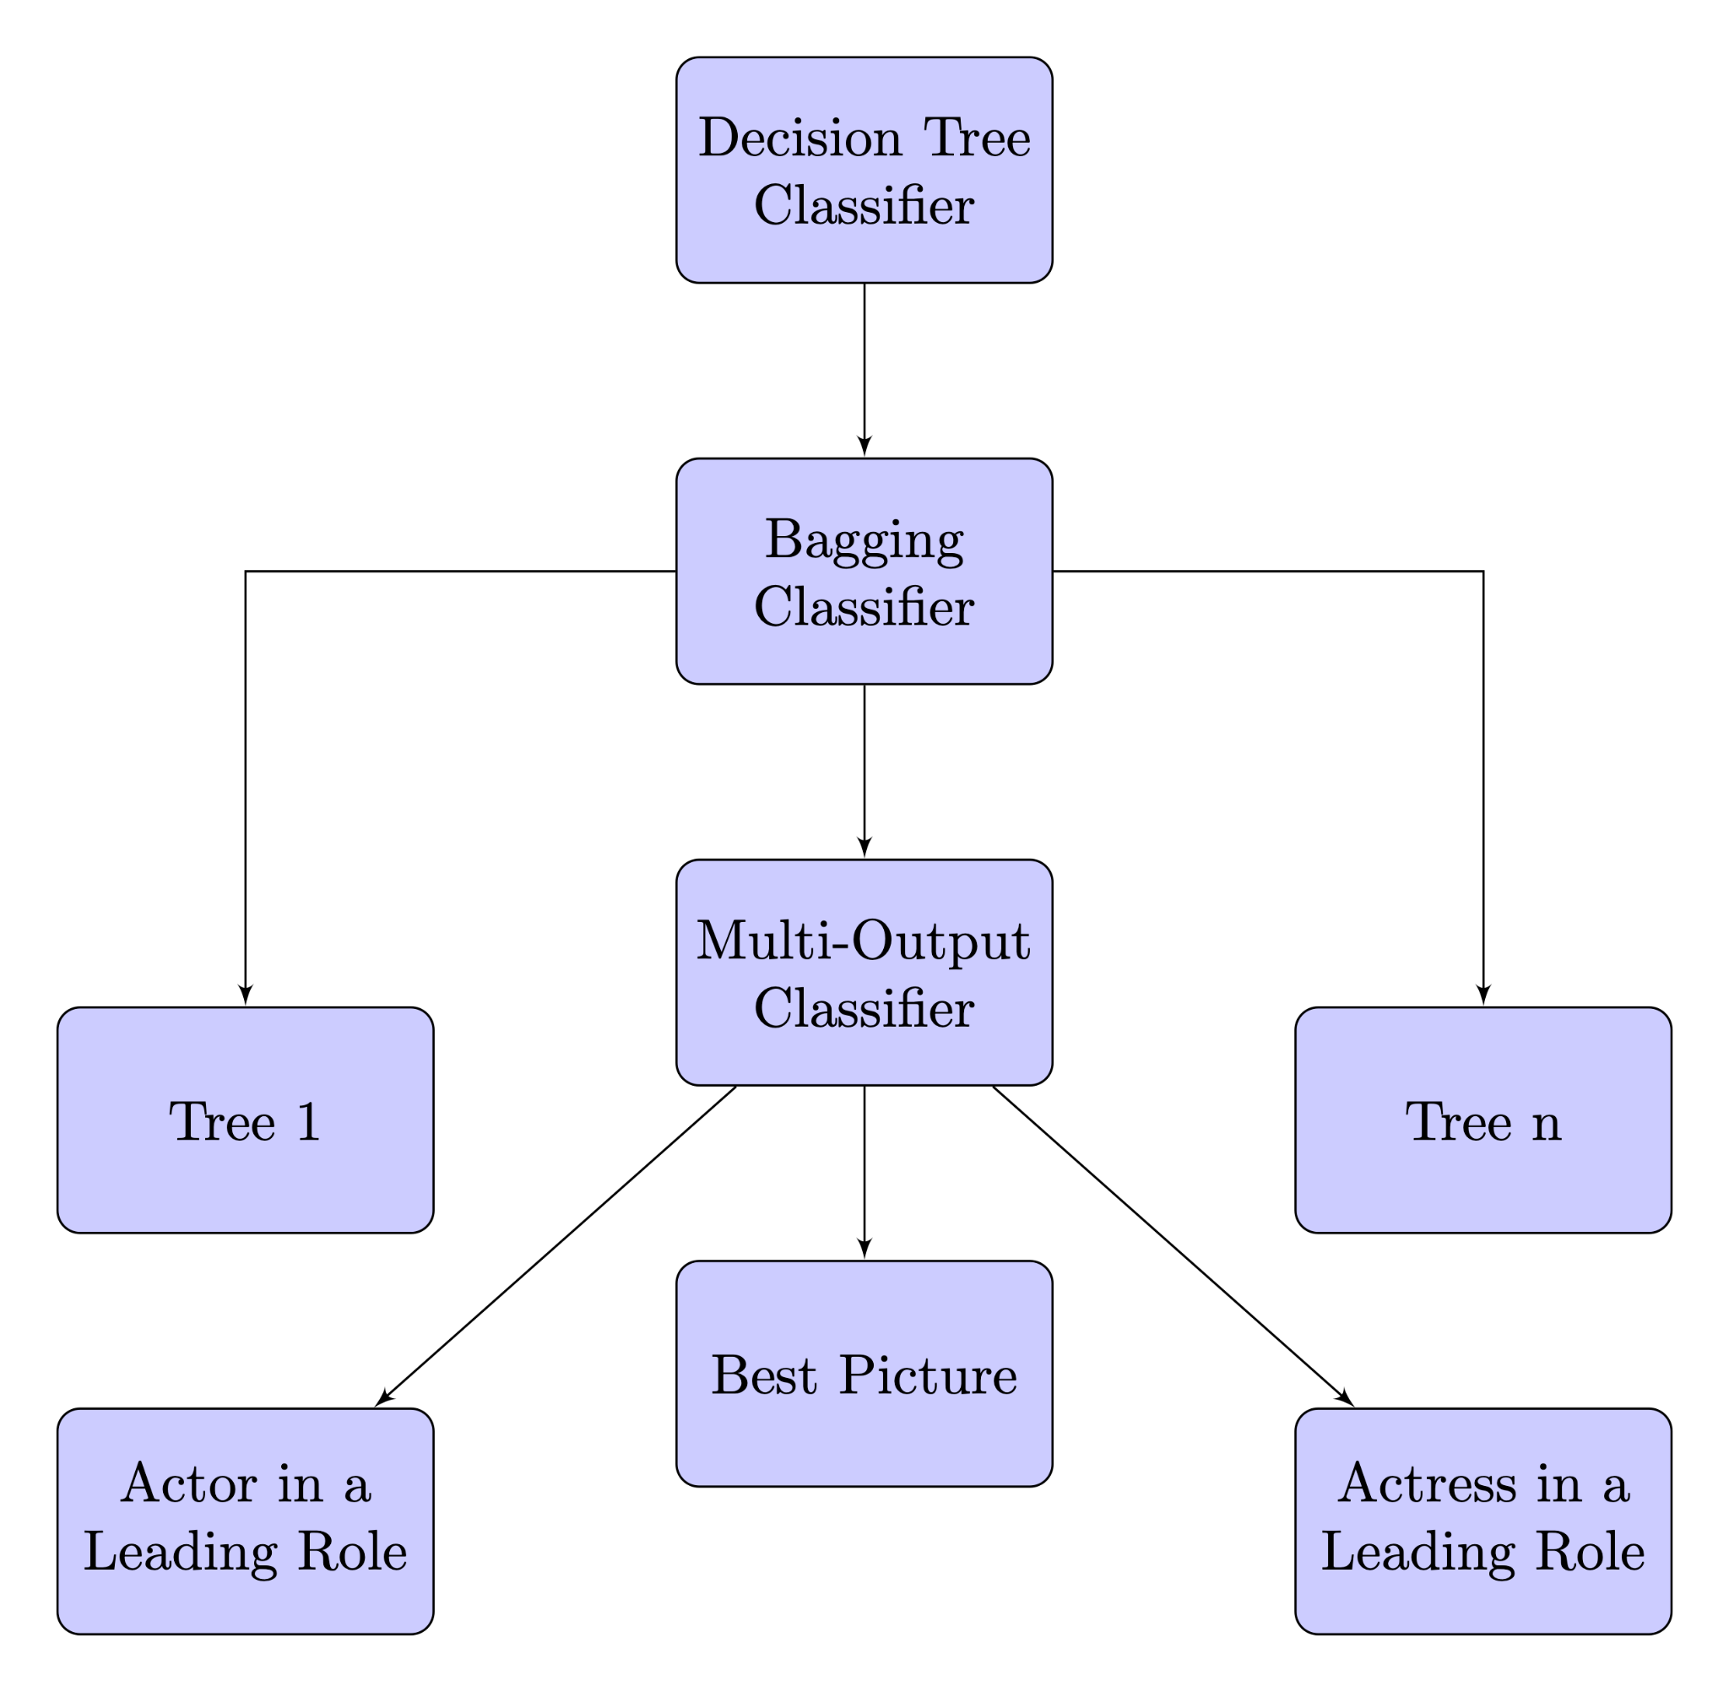

Method 3: Random Forest
Notes:
A Bagging Classifier,is an ensemble machine learning algorithm designed to improve the stability and accuracy of machine learning algorithms. It is used to reduce variance and avoid overfitting. Here's how it works:
Bootstrapping:
The core is bootstrapping, a statistical method. In bootstrapping, multiple subsets of the original training data are created using sampling with replacement. This means that each subset can have repeated instances, and some instances from the original dataset may not appear in a subset.
Training Multiple Classifiers:
For each bootstrapped subset, a separate model (or classifier) is trained. These models are usually of the same type (e.g., Decision Trees) and are trained independently of each other.
The idea is to exploit the different perspectives provided by the various subsets to achieve a more robust overall prediction.
Aggregating Predictions:
Once all models are trained, their predictions are combined (or aggregated) to make a final prediction.
For classification tasks, this aggregation is often done by majority voting, i.e., the final output is the class that receives the majority of the votes from individual models.
For regression tasks, the aggregation is typically the average of the predictions from all models.
A multiclass classifier is trained on a dataset where each instance is labeled with one of the multiple classes.
During training, the model learns to associate the features of the input data with the corresponding class labels.

Slide 30
Sklearn
base_cls = DecisionTreeClassifier()
bagging_cls = BaggingClassifier(estimator=base_cls, n_estimators=100, n_jobs=-1)
multi_target_forest = MultiOutputClassifier(bagging_cls, n_jobs=-1)
multi_target_forest.fit(X_train, y_train)

Slide 31

Random Forest: Training
Train on movies from 1927 to 2010
Validation on movies from 2011 to 2012
Test on movies from 2013 to 2017
Use 100 estimators in the forest

Slide 32

Random Forest: Testing
oscars_nominee_BEST PICTURE (F1 Score: 0.71)
Title | Predicted_Nomination | Actual Nomination
avatar 2 | No | Yes
nocturnal animals | Yes | No
hell or high water | No | Yes
moonlight | Yes | Yes
hacksaw ridge | Yes | Yes
arrival | No | Yes

Slide 33

Random Forest: Testing
Label Name | precision | recall | F1
oscars_nominee_ACTOR IN A SUPPORTING ROLE | 0.68 | 0.75 | 0.71
oscars_nominee_ACTRESS IN A SUPPORTING ROLE | 0.74 | 0.64 | 0.68
oscars_nominee_BEST PICTURE | 0.82 | 0.62 | 0.71
oscars_nominee_ACTOR IN A LEADING ROLE | 0.65 | 0.48 | 0.55
oscars_nominee_ACTRESS IN A LEADING ROLE | 0.82 | 0.56 | 0.67

Slide 34

Random Forest: Testing
Feature Importances for oscars_nominee_BEST PICTURE:
Feature_Name | Importance
gg_nominee_Best Director - Motion Picture | 0.326648
revenue | 0.098199
gg_nominee_Best Screenplay - Motion Picture | 0.085398
runtimeMinutes | 0.031767
gg_nominee_Best Motion Picture - Drama | 0.031571
numVotes | 0.030175
actor2Age | 0.027014

Slide 35
Random Forest: Testing
Feature Importance oscars_nominee_ACTOR IN A LEADING ROLE:
Feature_Name | Importance
sag_nominee_LEADING ROLE - MALE | 0.333789
gg_nominee_Best Performance by an Actor | 0.131328
actor1Age | 0.044782
actress2Age | ¸0.040476
revenue | 0.032088
numVotes | 0.030052
budget | 0.027817

Slide 36
Random Forest: Testing
Feature Importances for oscars_nominee_ACTRESS IN A LEADING ROLE:
Feature_Name | Importance
sag_nominee_LEADING ROLE - FEMALE | 0.360435
gg_nominee_Best Performance by an Actress | 0.072320
actress3Age | 0.051496
gg_winner_Best Performance by an Actress | 0.044117
runtimeMinutes | 0.032789
actor2Age | 0.032717
actress2Age | 0.031936

Slide 37

Random Forest: Conclusions
Golden Globes Nominations could be a good indicator of oscar winning
Revenue Plays a big role in winning (popularity?)
Actor ages plays an important role, too.
The dataset is very unbalanced, that may explain why our models

Slide 38
Model Comparison

Slide 39
Best Pictures Nomination
 | Logistic Regression | Neural Network | Random Forests
Accuracy | 0.99 | 0.99 | 0.99
Balanced Accuracy | 0.87 | 0.76 | 0.81
Precision | 0.77 | 0.76 | 0.82
Recall | 0.73 | 0.51 | 0.62
F1 Score | 0.75 | 0.61 | 0.71
Most Important Feature (Positive) | gg_nominee_Best Screenplay (Motion Picture) | gg_nominee_Best Screenplay (Motion Picture) | gg_nominee_Best Director - Motion Picture
Most Important Feature (Negative) | languageOther
?
2024
Notes:
A multiclass classifier is trained on a dataset where each instance is labeled with one of the multiple classes.
During training, the model learns to associate the features of the input data with the corresponding class labels.

Slide 40
Best Actor Nomination
 | Logistic Regression | Neural Network | Random Forests
Accuracy | 0.99 | 0.99 | 0.99
Balanced Accuracy | 0.89 | 0.87 | 0.74
Precision | 0.77 | 0.68 | 0.65
Recall | 0.73 | 0.74 | 0.48
F1 Score | 0.75 | 0.71 | 0.55
Most Important Feature (Positive) | sag_nominee_LEADING ROLE - MALE | runtimeMinutes | sag_nominee_LEADING ROLE - MALE
Most Important Feature (Negative) | languageEnglish
?
2024
Notes:
A multiclass classifier is trained on a dataset where each instance is labeled with one of the multiple classes.
During training, the model learns to associate the features of the input data with the corresponding class labels.

Slide 41
Best Actress Nomination
 | Logistic Regression | Neural Network | Random Forests
Accuracy | 0.99 | 0.99 | 0.99
Balanced Accuracy | 0.88 | 0.91 | 0.78
Precision | 0.48 | 0.52 | 0.82
Recall | 0.75 | 0.81 | 0.56
F1 Score | 0.59 | 0.63 | 0.67
Most Important Feature (Positive) | gg_nominee_Best Performance by an Actress in a Motion Picture - Drama | gg_nominee_Best Performance by an Actress in a Supporting Role in any Motion Picture | sag_nominee_LEADING ROLE - FEMALE
Most Important Feature (Negative) | productionCompanyColumbiaPicturesCorporation
?
?
2024
Notes:
A multiclass classifier is trained on a dataset where each instance is labeled with one of the multiple classes.
During training, the model learns to associate the features of the input data with the corresponding class labels.

Slide 42
References
[1] Predicting the oscars using preferential machine learning. Towards Data Science.
[2] R. Banik. The movies dataset. https://www.kaggle.com/datasets/rounakbanik/the-movies-dataset, 2023.
[3] S. Deregowski. Oscar-predictions, 2022.[4] IMDb. Imdb data files available for download. https://datasets.imdbws.com/, 2023. Documentation can be found at http://www.imdb.com/interfaces/.
[5] J. Kim, S. Hwang, and E. Park. Can we predict the oscar winner? a machine learning approach with social network services. Entertainment Computing, 39:100441, 2021.
[6] UNIMAD. Golden globe awards. https://www.kaggle.com/datasets/unanimad/golden-globe-awards, 2023.
[7] UNIMAD. The oscar award, 1927 - 2023. https://www.kaggle.com/datasets/unanimad/the-oscar-award, 2023.
[8] UNIMAD. Screen actors guild awards, 1994 - 2020.https://www.kaggle.com/datasets/unanimad/screen-actors-guild-awards, 2023.
[9] Scikit-learn, "Machine Learning in Python — scikit-learn 0.24.2 documentation," [Online]. Available: https://scikit-learn.org/stable, 2023.
[10] user12075 (2023, April 10). MLPRegressor learning_rate_init for lbfgs solver in sklearn [Answer]. Stack Overflow. https://stackoverflow.com/a/60902315/12075

Slide 43

2024
Best Picture
Prediction

Slide 44
Thank You

